Slide 1
Observations Re: Week 1 Assignments

Slide 2
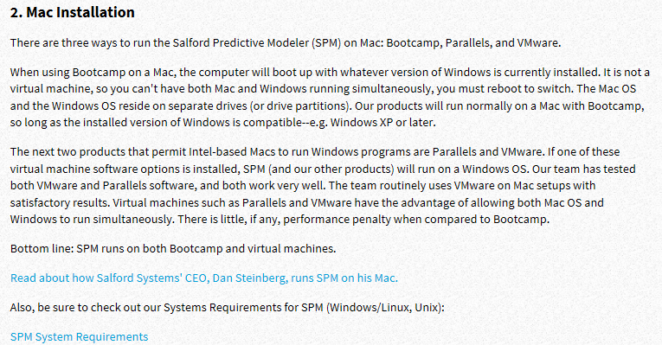
MAC Users
https://info.salford-systems.com/january-tech-support-cases

Slide 3
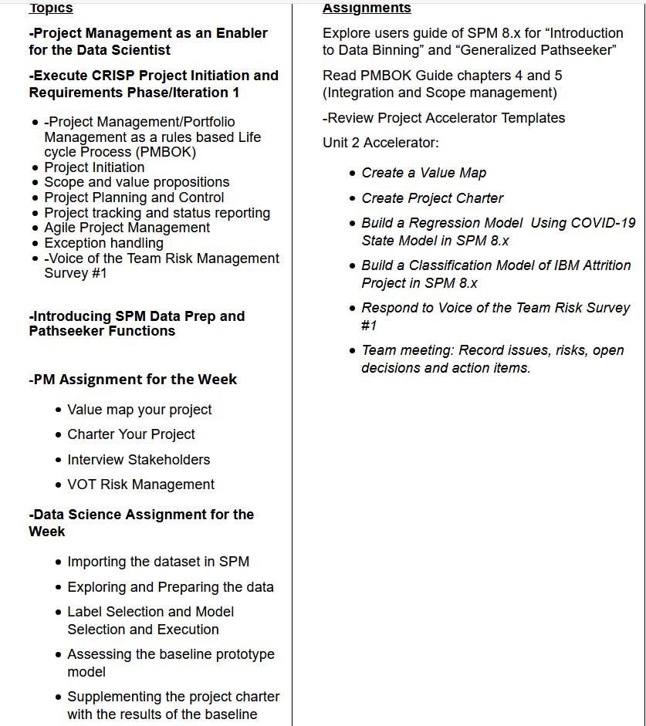

Slide 4
Project Initiation

Slide 5
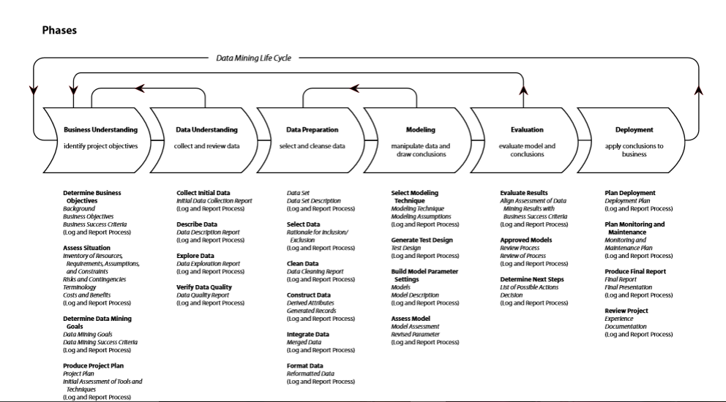
A Revised CRISP-DM Project Methodology with Deliverables
Deploy To Production
#4
Baseline Model
#1 and Report
Enhanced Model; Create and Deploy Workbooks
#2
Test Enhanced Model
#3 For Server/Cloud
Post Project Monitoring
Project Charter, Value Map and Requirements
Baseline Project Schedule
Business Sign-off and Project Authorization. Scope Change Control
First Prototype Completed in Dev Environment
Weekly Risk Management Survey—VOT Begins
Issues and Gaps Documented
Phase Exit Review Completed
Weekly Status Begins
Community-Social Media Begins
Deploy Model to PRD
Load/Validate PRD Data
Go Live in PRD
Stabilization
System monitoring
Model Updates
Value Monitoring and
Management
Community Social Media Continues
Second Prototype Completed in Dev Environment
Future State Process Developed with ETL Data Modeled
Future State Process Documented
Schedule Updated
Issues and Defects Captured and Closed
Phase Exit Review Completed
Weekly VOT Continues
Weekly Status Continues
Community Social Media Continues
Third Prototype Created
Test Scripts Created
and Executed in QA
User Acceptance Testing
Completed with full data
Training Scripts Created
User Training Delivered
Issues and Defects Closed
Community Social Media
Continues for communication

Slide 6
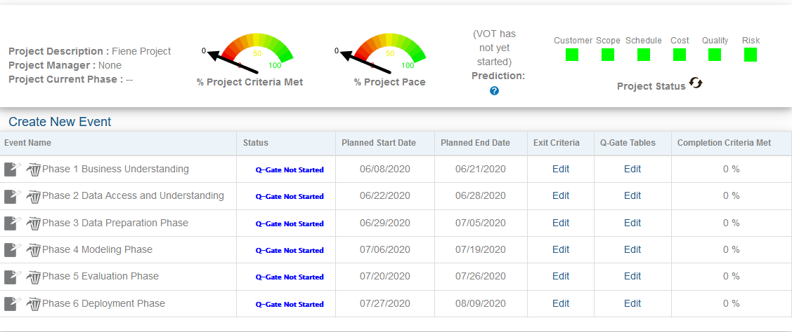

Slide 7
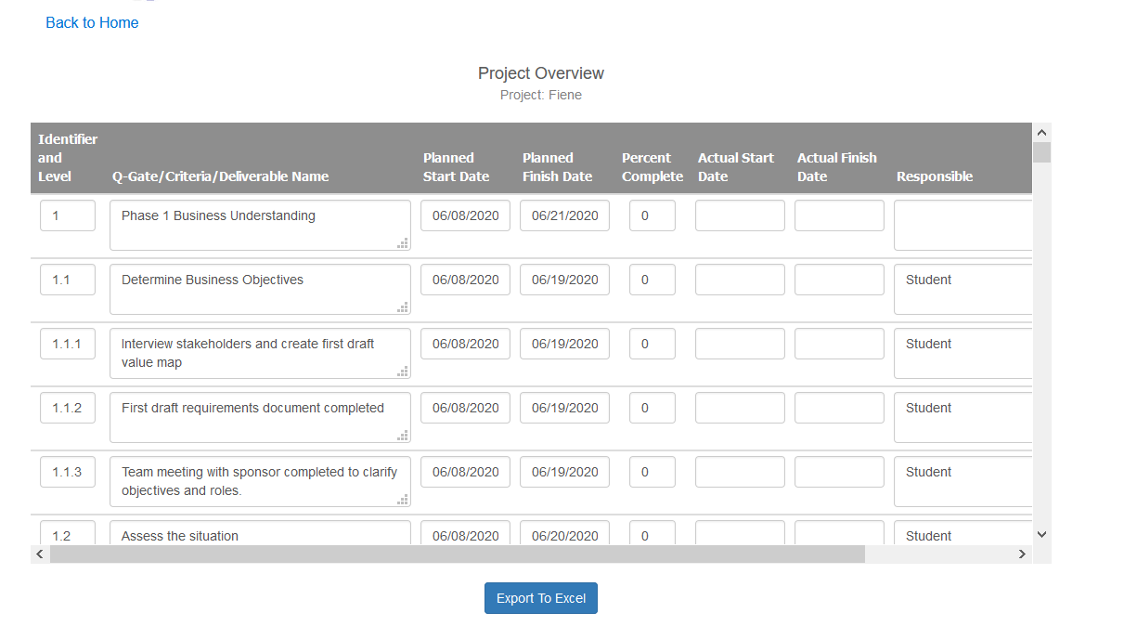

Slide 8
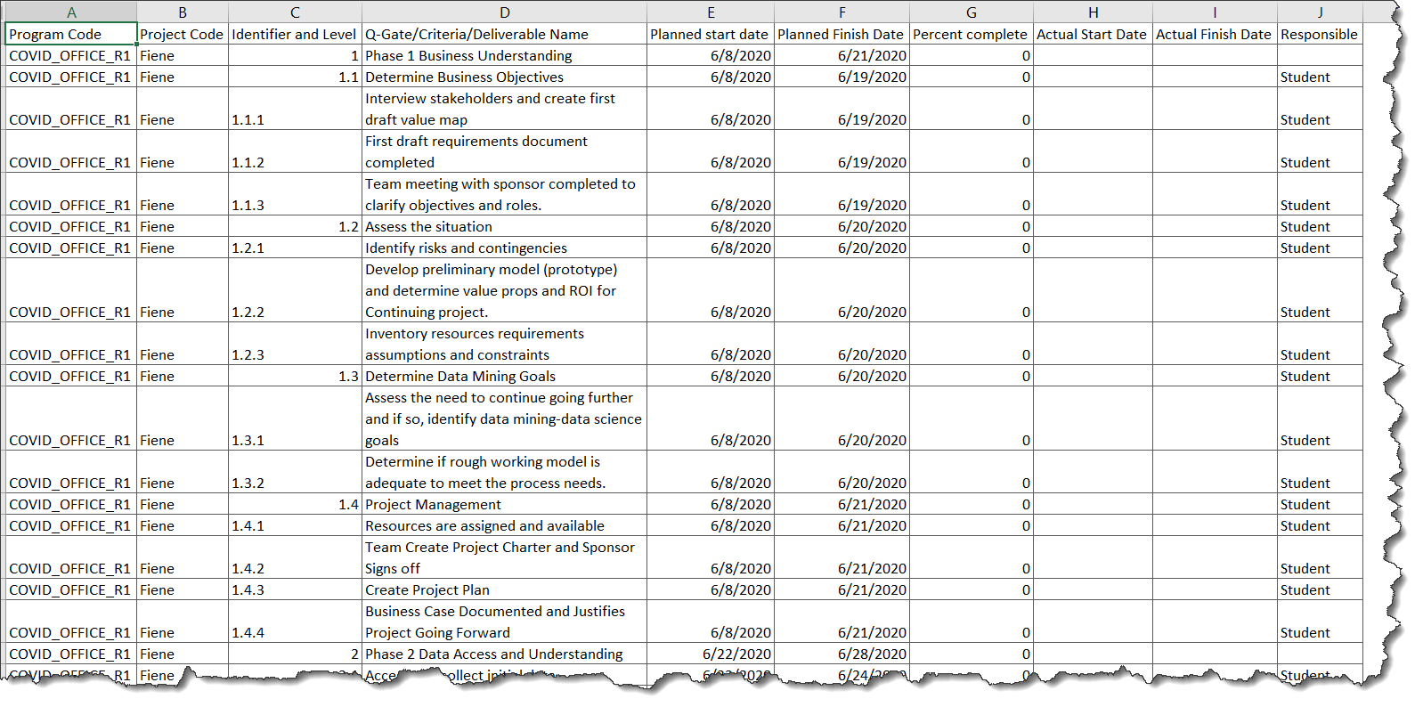
Phase 1

Slide 9
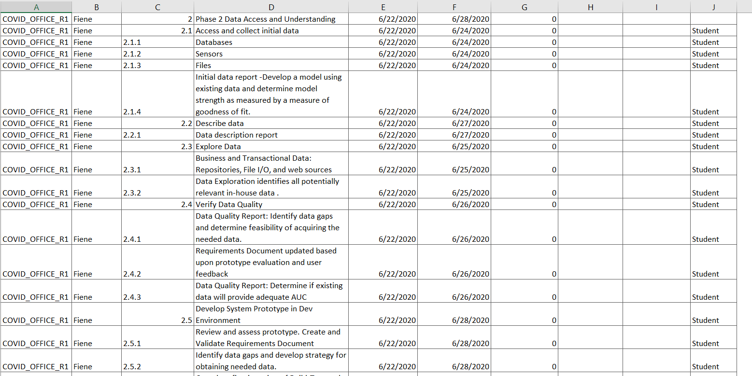
Phase 2

Slide 10
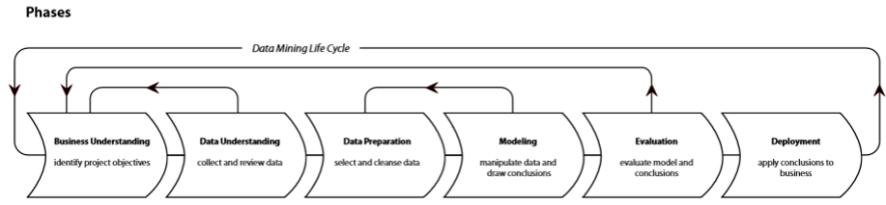
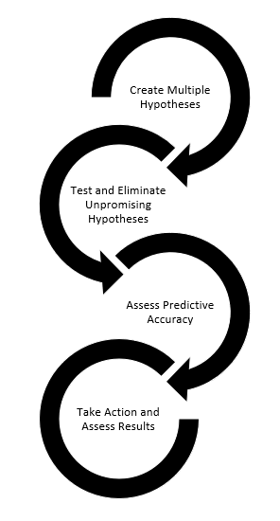
Once the ML Model is Progressively Proven In Value, It is Deployed With Increasing Investment
Where we Left off in MDS 560
Deploy to Server or Cloud
Deploy Excel Workbooks to Users
Second Iteration
Modeling at Desktop Only
Third Iteration
Modeling at Desktop or Cloud
First POC Prototype
User Desktop Only
Value From Better
Decision Making In a Function/Process
Value From Better
Decision Making En Masse
Value From Insights

Slide 11
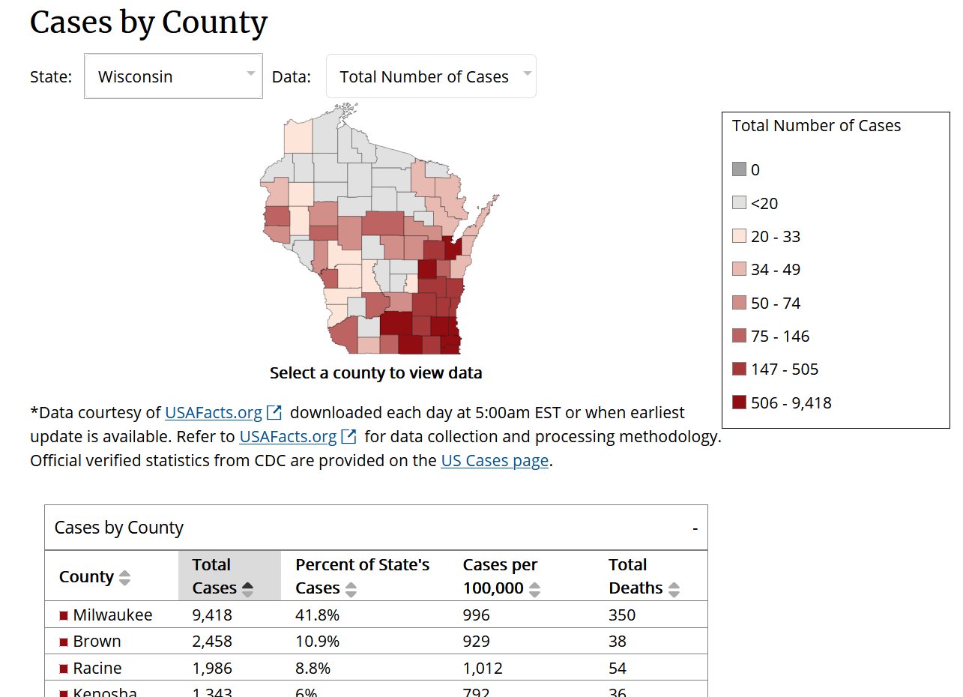
www.cdc.gov
Can you trust the data?
Does data distinguish between COVID and the Flu/Pneumonia? Medically similar.
Hypothesis Testing Is Needed

Slide 12
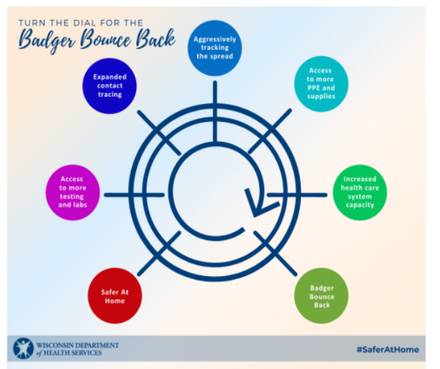
Elements of the Wisconsin Recovery Plan

Slide 13
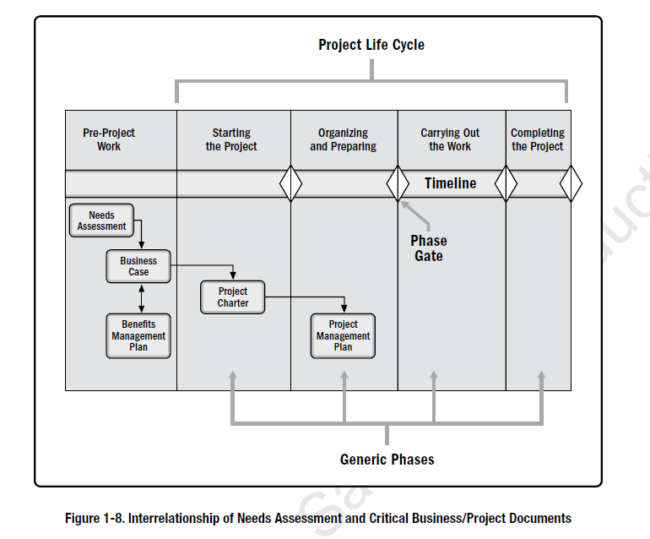

Slide 14
Peirce’s Trichotomy of the Scientific Method
As Self-Correcting Cycles Leading to the “Truth”
Multiple
Hypotheses
Refer to K. Popper
Abductive
Reasoning
Begin Next Cycle with Convergence on “Truth”
What are Testable Conclusions About Other Phenomenon That Must Be Reached For Each Hypothesis if True?
Controlled Experiments Statistical Not Practical
Explanatory
Hypotheses
Experience
What Must
Happen If True?
Deductive
Reasoning
Begin Research
Assess Results of Application and Adjust Hypotheses
A Question
Sufficient Accuracy Reached to Take Action
Elimination
of False Hypotheses
(retroduction)
Test Predictive
Models
Execute Actions
Inductive
Reasoning
Assess Accuracy
Economics Plays a Role in Sufficiency Decision.

Slide 15
Once the ML Model is Progressively Proven In Value, It is Deployed With Increasing Investment
Not Necessarily the Same Model Deployed
Deploy to Server or Cloud
Deploy Excel Workbooks to Users
Second Iteration
Modeling at Desktop Only
Third Iteration
Modeling at Desktop or Cloud
First POC Prototype
User Desktop Only
Value From Better
Decision Making In a Function/Process
Value From Better
Decision Making En Masse
Value From Insights

Slide 16
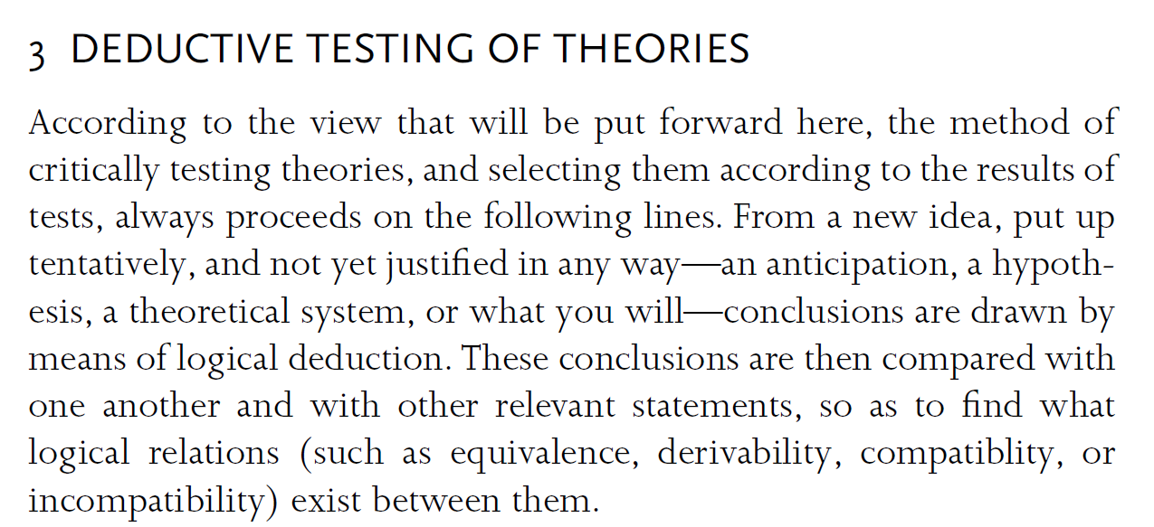
Popper Chapter 1

Slide 17
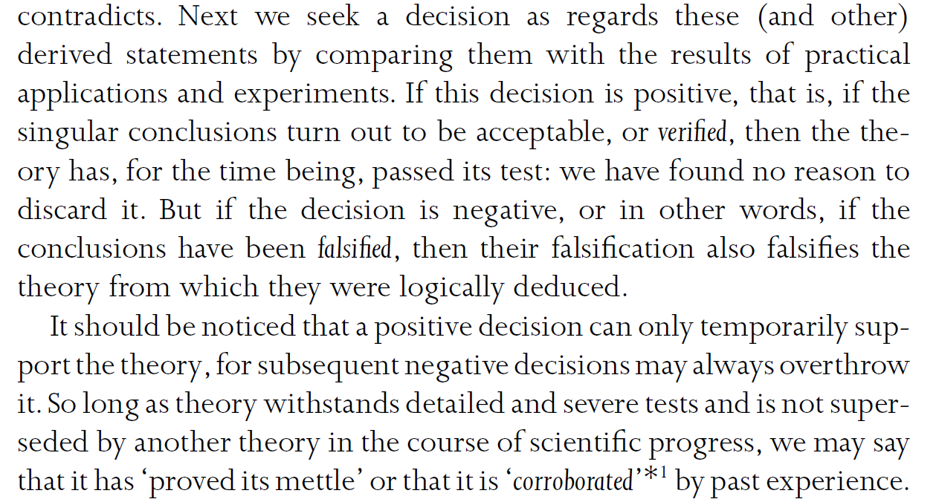
Popper Chapter 2 Continued

Slide 18
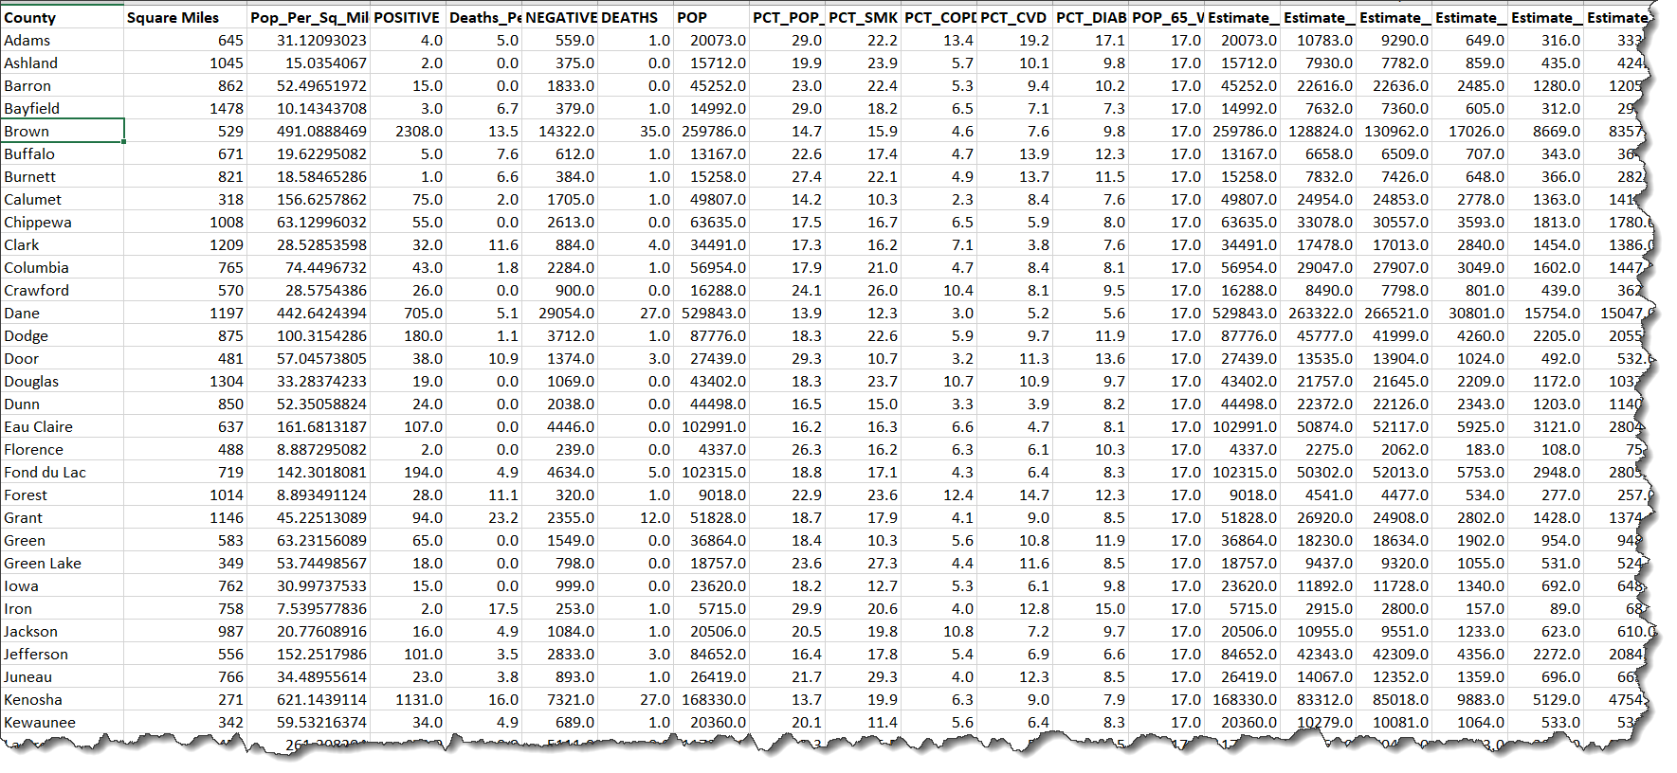
Data Sets Available From States Merged With Census Data
Example: Wisconsin Starter Data Set

Slide 19
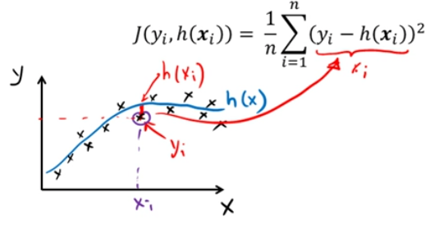
Modeling Provides Both Explanation and Prediction
Explanation is Tied to Hypothesis Testing
R² = 1-RSS/TSS
Y
1-RSS=ESS
Y
Average
Average
X
X
The typical least squares cost function

Slide 20
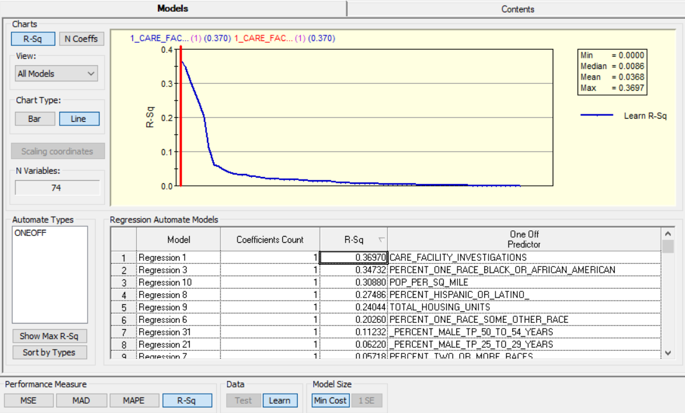

Slide 21
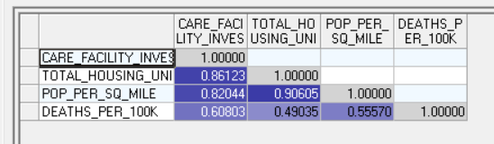
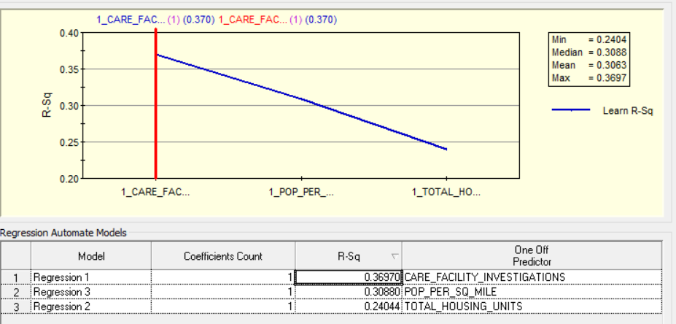

Slide 22
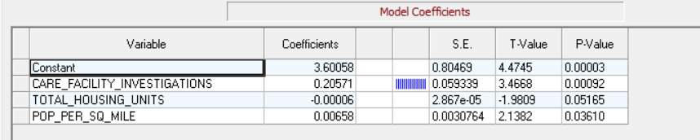
Will Other States Produce Similar Results?

Slide 23
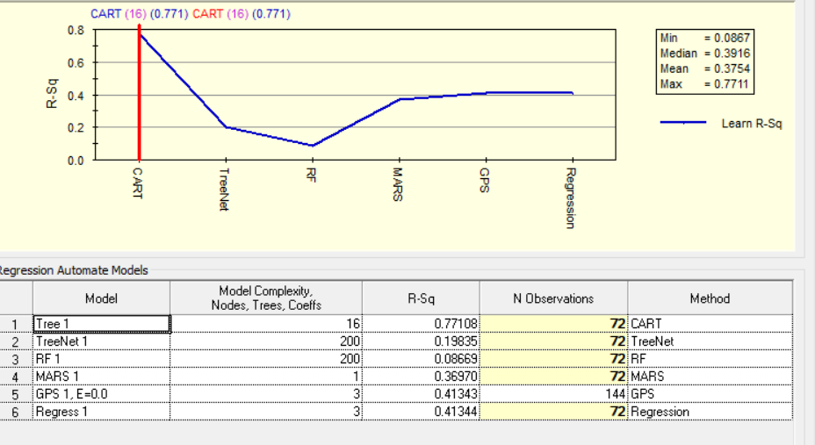

Slide 24
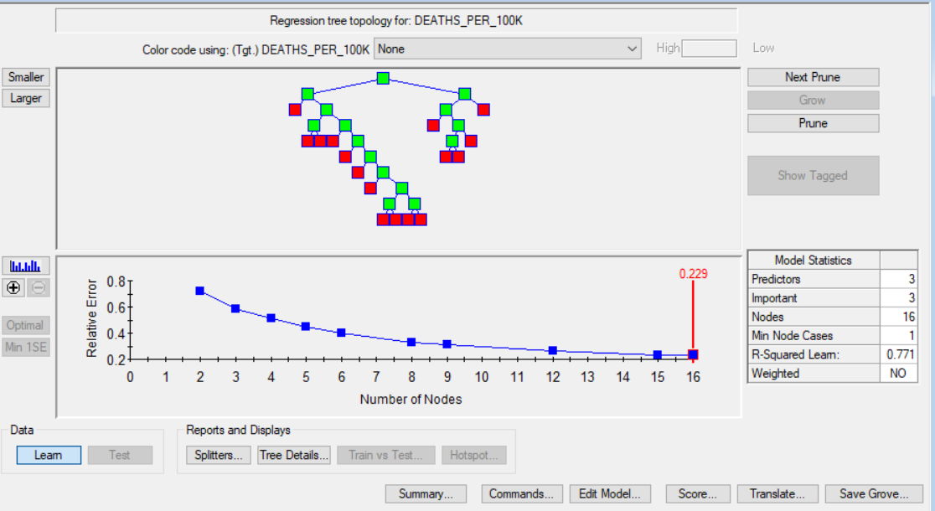

Slide 25
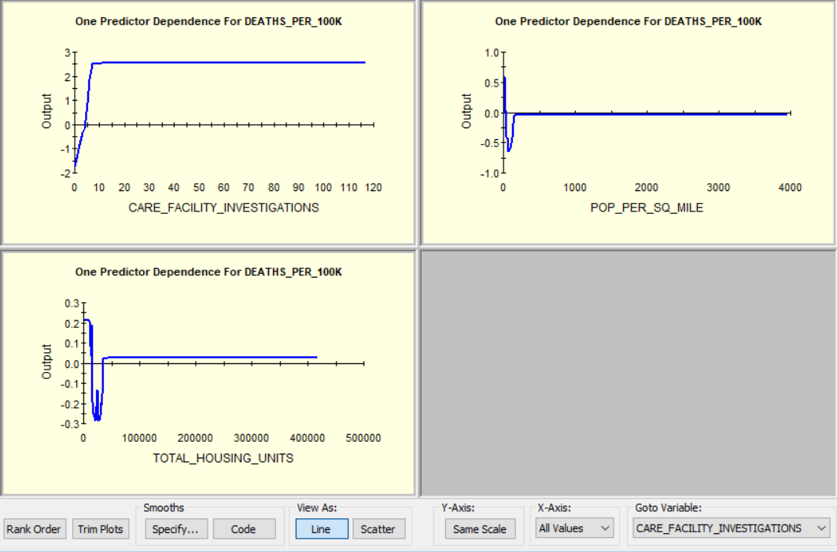

Slide 26
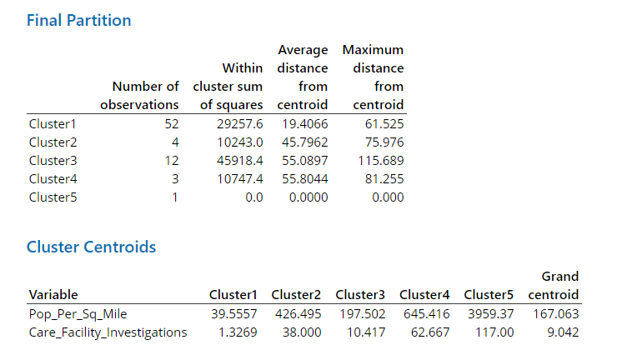

Slide 27
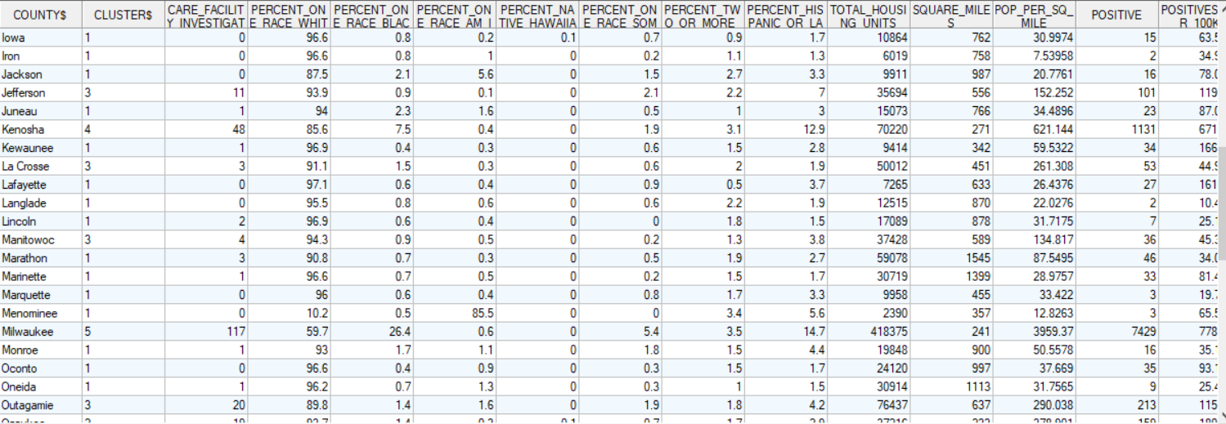
Cluster Added to Data Set

Slide 28
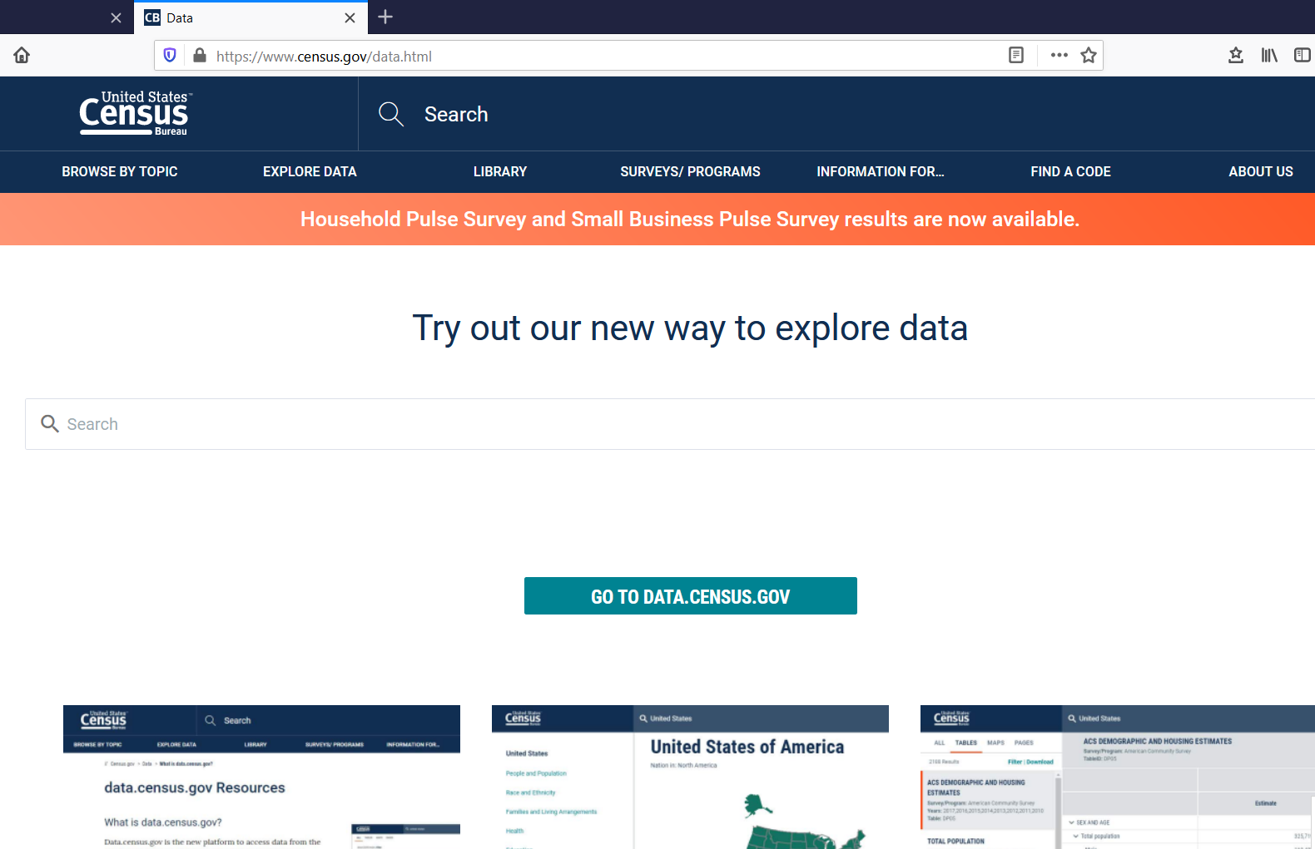
Adding Demographic Data (www.census.gov)

Slide 29
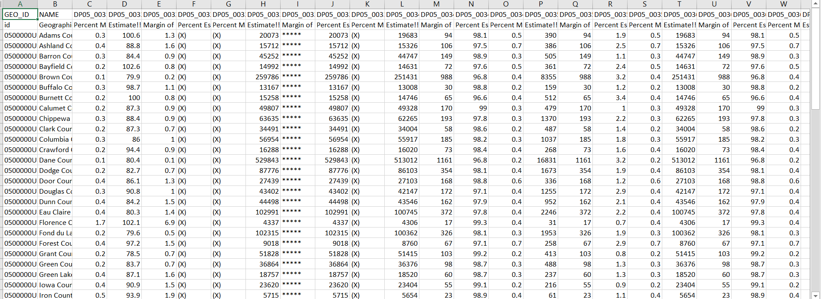
Example of Census Data

Slide 30
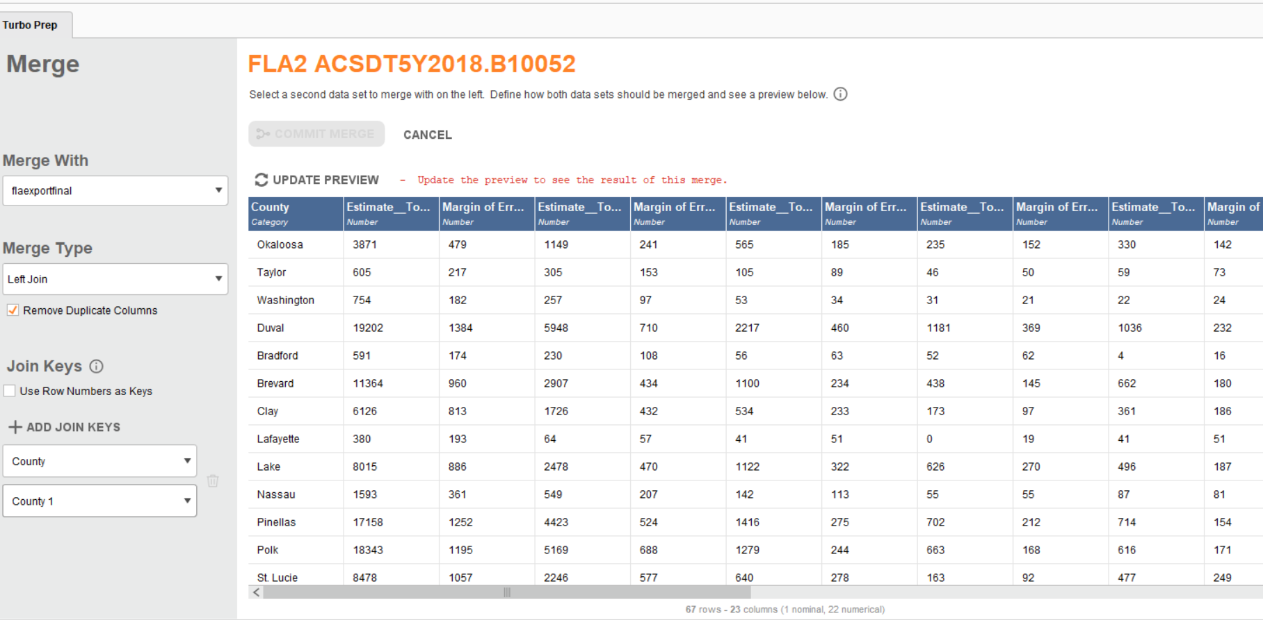
Table Joining Utilities Available in Tableau, MS Access, or Rapidminer (below)

Slide 31
Your Assignment This Week Will Be To Take Your Project Through Phase 1 and Phase 2 of Crisp Life Cycle Methodology

Slide 32
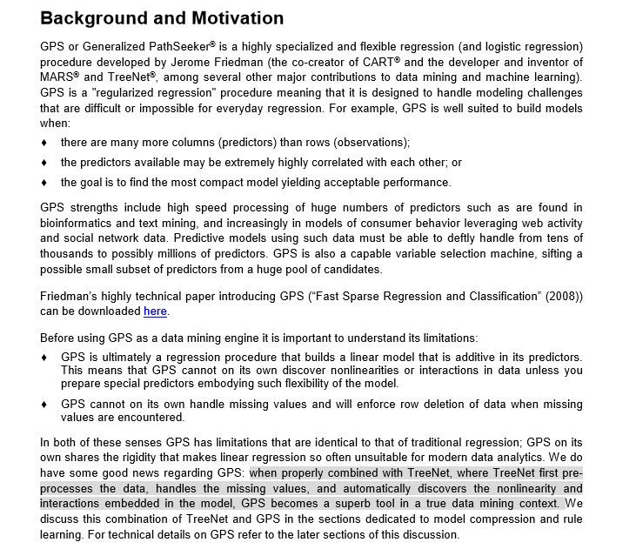
General Path Seeker (GPS)—Regularized Logistic Regression Regression

Slide 33
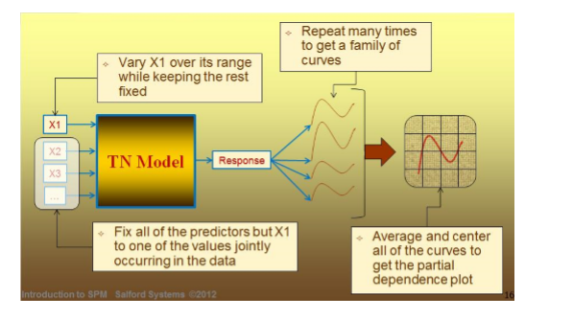
Partial Dependency Plots of Treenets Are Highly Insightful

Slide 34
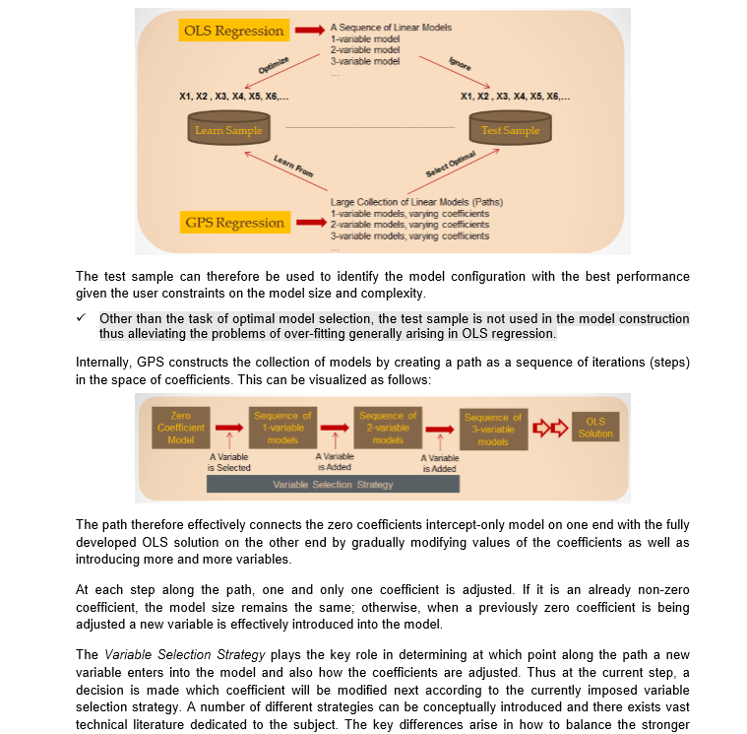

Slide 35
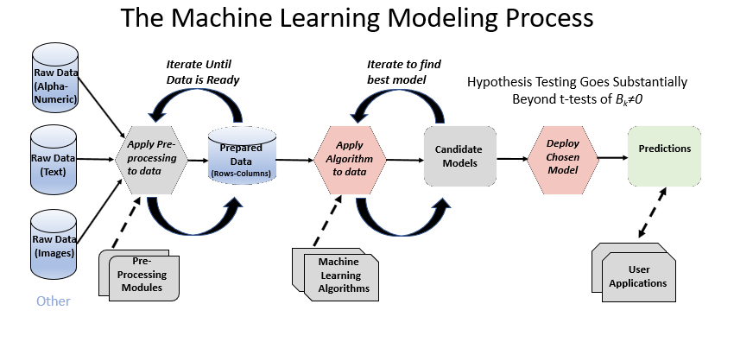

Slide 36
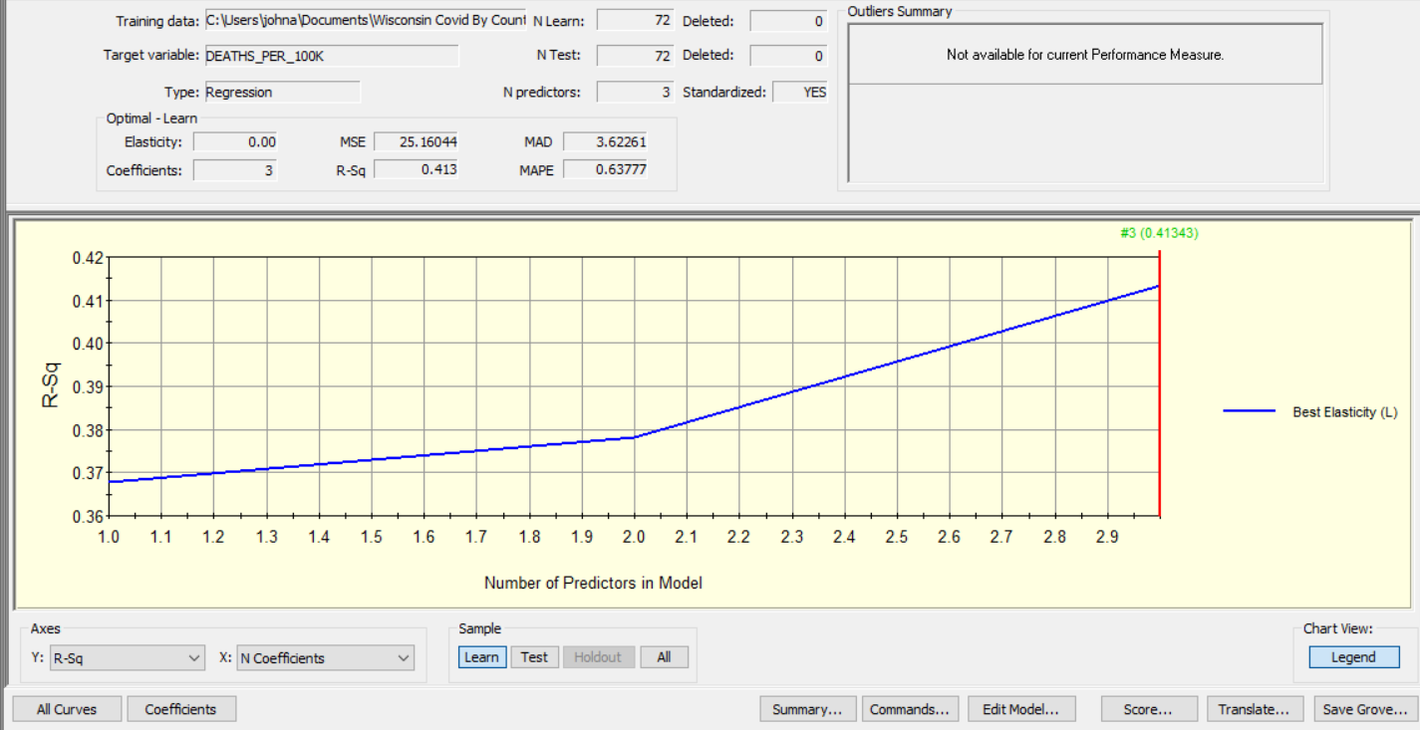

Slide 37
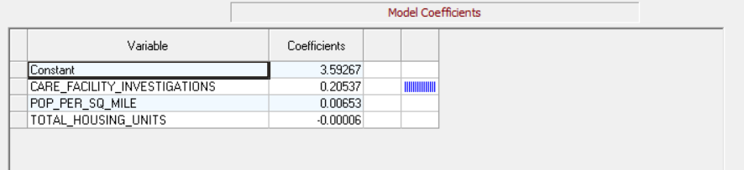
Regression Coefficients

Slide 38
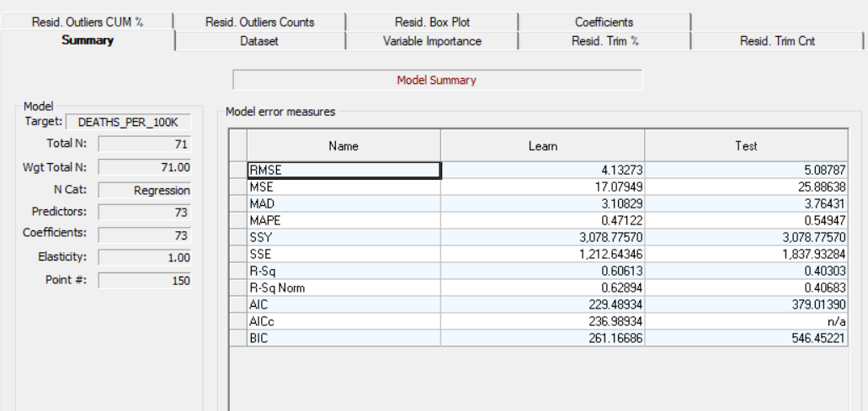

Slide 39
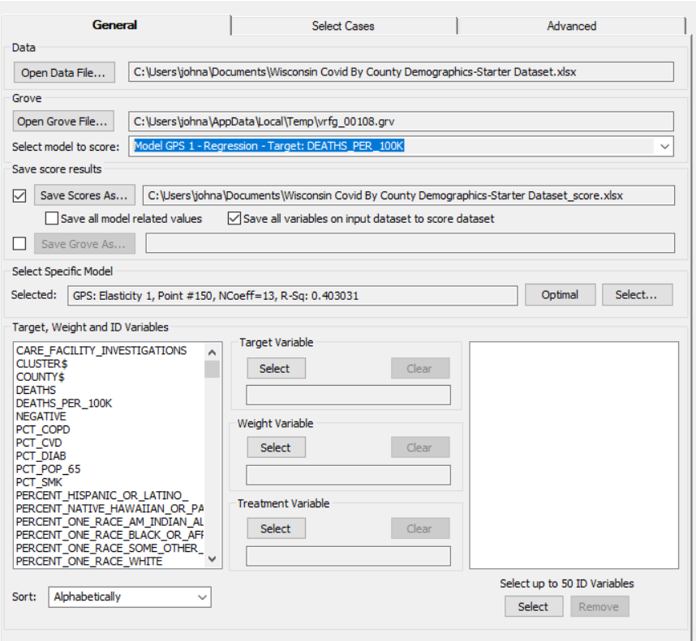

Slide 40
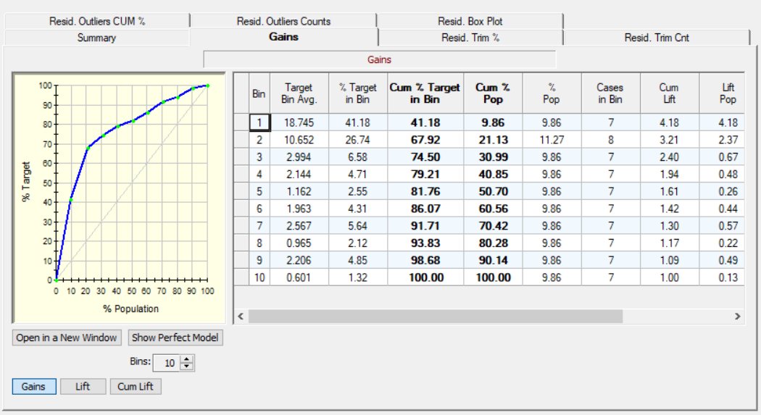

Slide 41
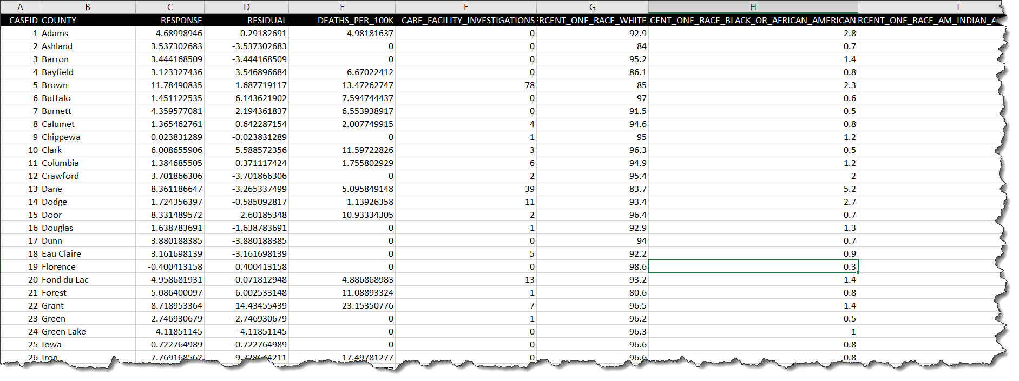

Slide 42
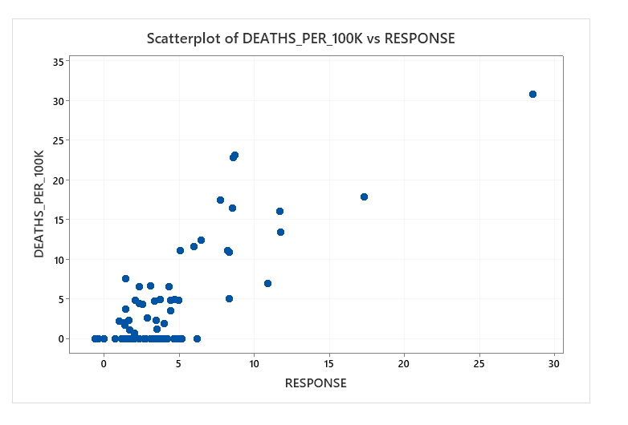

Slide 43
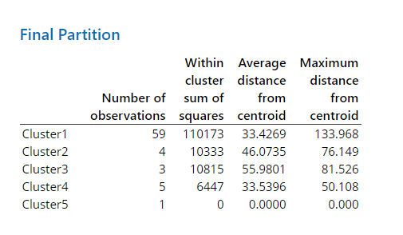
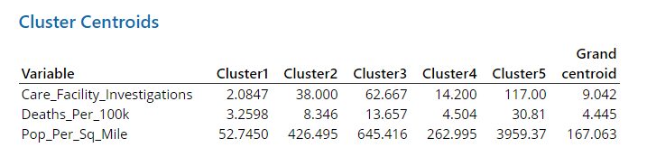

Slide 44
Start With Business Case
Problem to be solved or opportunity to be captured
Compelling case to act NOW
Benefits must exceed costs
Risks to be considered
Alternatives to project
What are Value Props?

Slide 45
Value Mapping Overview
Value Map
Performance Map
Strategy
Examples of Value Props (Critical Success Factors)
Processes Changes (PPIs)
Enablers
Procedures
KPI
Quotations
Configurator
Business Process Procedures (BPP)
Improved Competitive
Position
Reduced
Cycle Time
Part numbering
Increased
Market
Share
--P&L
--Balance sheet
KPI
Operational Efficiencies
Reduced labor per transaction
Value Drivers
Improved supplier pricing
KPI
Revenue & Margin Growth
Increased Revenue
Increased margins (pricing)
KPI
Customer Satisfaction
Improved Quality
Others

Slide 46
Value Mapping
Value Premise:
Business value results from process change; technology is an enabler
Process change optimizes value achieved
Why Value Map?
Connect the business case to solution design
Group key process changes from multiple Value Maps by functional team
Communicate operational program benefits for improved change management
Set expectations early for benefit delivery accountability
Maintain Value Maps as “living” documents to be reviewed during each phase of the implementation and post implementation assessment

Slide 47
Value Mapping: Definition, Approach & Timing
Value Mapping Definition
Identifying business process in scope, clarify our vision for improvements and changes required to develop the business case value objectives.
Value Mapping Approach
Select significant processes and value drivers (first cut)
Determine what key process changes are required
Determine how to measure the key process changes
Develop meaningful and measurable KPI’s and establish ownership (first cut)
Identify value enablers that support process changes
Value Mapping Timing
Value mapping will be performed during the initiation phase.
Value mapping will enable the team and stakeholders to better evaluate objectives and scope.

Slide 48
Value Mapping Approach Select Significant Processes and Value Drivers
Owner
EXAMPLE
Reduce SG&A
Process | Value Driver | Financial KPI | $4.9M | $9.2M
Procurement | Improve Indirect Annual Savings | Avg. Annual Savings (Indirect) | $3.3M | $6.6M
Procurement | Reduce Indirect Maverick Spend | Maverick Spend (%) | $1.1M | $1.6M
Procurement | Improve Transactional FTE Efficiency | FTEs per billion spend | $0.4M | $0.8M
Finance | Standardize financial reports | Cost of Finance analytics as % of SG&A | $0.1 | $0.2
Reduce COGS
Process | Value Driver | Financial KPI
Manufactur. | Improve Manufacturing Yield & Quality | Mfgr. Cost as % of COGS
Procurement | Reduce Direct Material Spend | Direct Spend as a % COGS
Reduce Working Capital
Process | Value Driver | Financial KPI
Sales & Ops Planning | Reduced Finished Goods Inventory | Days in Inventory
Increase Revenue Growth
Process | Value Driver | Financial KPI
Cust. Service | Reduced # of disputes/write-offs | Days in Inventory

Slide 49
Value Mapping Approach Identify Value Enablers that Support Process Changes
Value Proposition
 | Key Process Change |  |  |  | KPIs
A1 | Develop Contract Management and Compliance discipline to manage contract/agreement execution, value capture (i.e. discount/rebate), contract expiration notification, etc |  |  |  | % Spend to Contract % Contract Compliance
 |  | Value Enabler | Enabler Type | Supporting Information | Owner | Planned Completion
 | A1a | Develop process to manage contract lifecycle including both Legal Contracts and Transactional Contracts/Catalogs Expiration risk Rebate thresholds Purchase discounts Spend to target Contracted savings | Process | Importance: The contract lifecycle, including both legal and technical contracts, is complex. The complexity of this end-to-end process introduces risk of lost savings opportunity (unrealized rebates or discounts, unexpected contract expiration, etc.). In addition it may lead to faulty compliance. To avoid savings and compliance shortfalls, a well defined contract lifecycle management process with appropriate analytics must be in place Challenge: Process complexity with cross-organizational handoffs and multiple systems Objective: Develop a process that eliminates the risk of lost savings and compliance failure | [Name] | [Date]
 | A1b | Obtain mandate from management through clear communication of Compliance policy Consequences of non-compliance | Governance | Importance: Understanding that compliance is a management priority and understanding the ramifications of failure to comply are both necessary for meeting compliance objectives Challenge: Providing a consistent message across all divisions Objective: obtain a clearly articulated management mandate for contract compliance and the consequences of non-compliance | [Name] | [Date]
EXAMPLE
Requirement

Slide 50
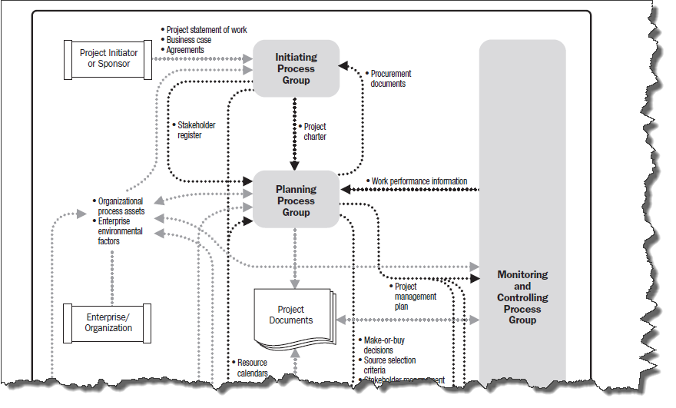
Initiating the Project

Slide 51
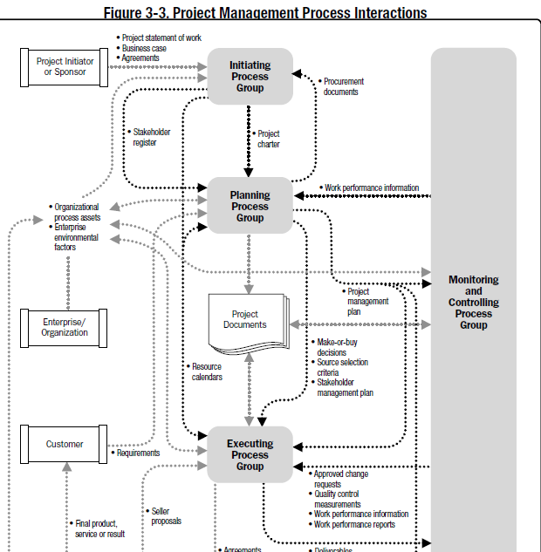

Slide 52
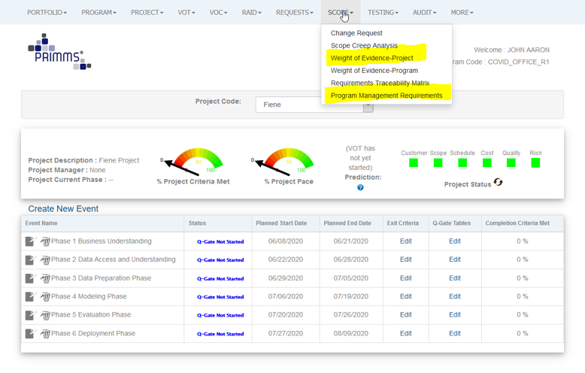

Slide 53
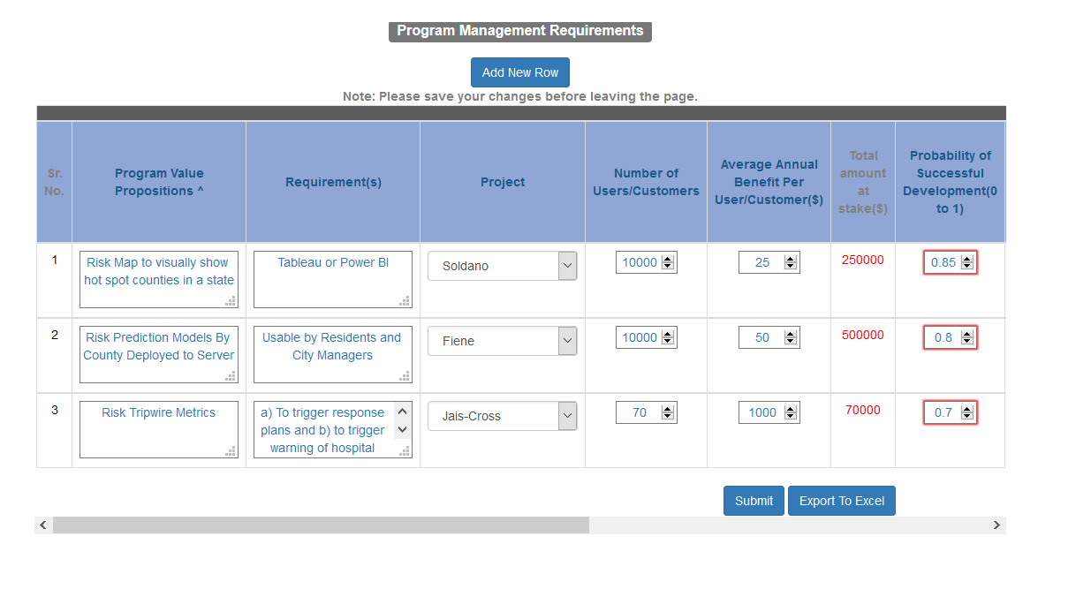

Slide 54
Project Charter Template
Date

Slide 55
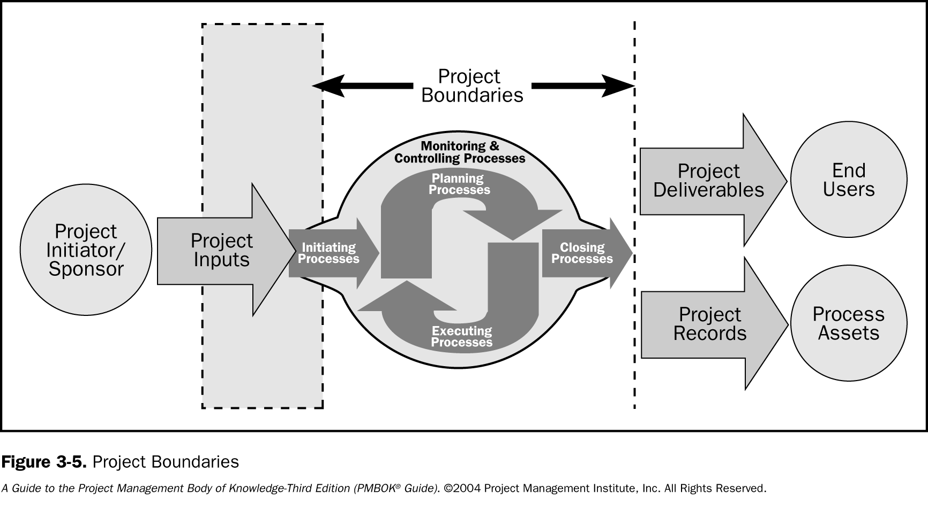

Slide 56
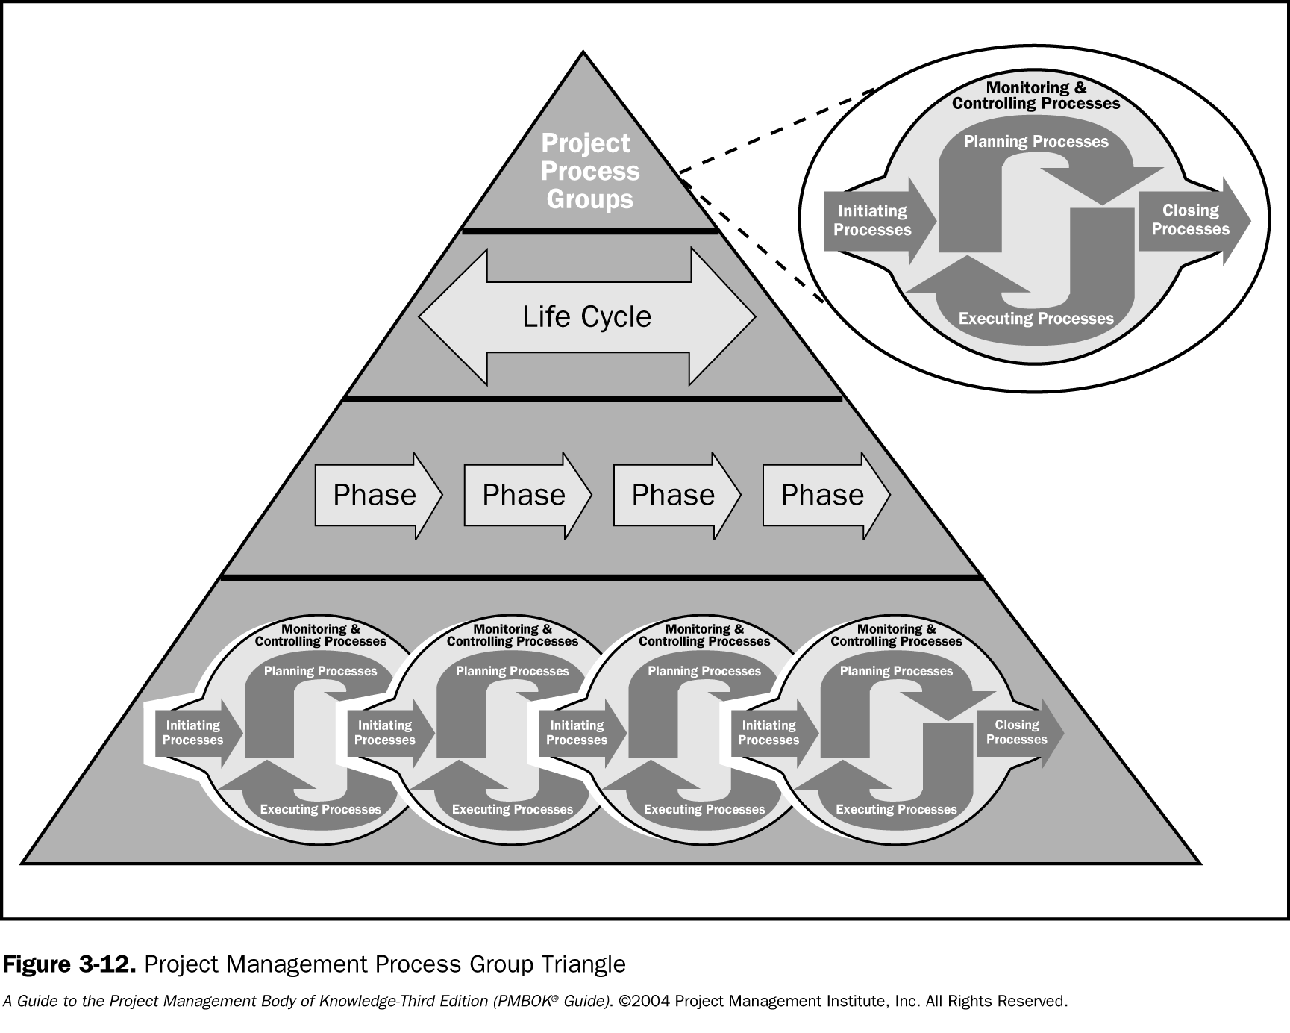

Slide 57
Adding Data to the Model

Slide 58
